Slide 1



Password Security System
Implementing Password Verification with XNOR Gates and Error Counting Using JK Flip-Flops

Slide 2
Group Members
22-47495-2 | Shanto Debnath
23-50251-1 | Fahima Islam
22-46666-1 | Arafat Helal
22-48144-2 | Mahfuz Ahmed Akand
22-47485-2 | Shoham Podder

Slide 3
TABLE OF CONTENTS
01
02
03
04
Introduction
Objectives
Problem
Statement
Block
Diagram
05
06
07
08
Methodology
Simulation
Discussion
Project
Prototype

Slide 4
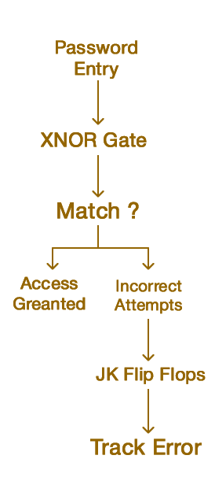
Introduction
This project demonstrates a password security system using simple electronics.
XNOR gates perform bit-by-bit password comparison, ensuring precise validation.
JK flip-flops count incorrect attempts and reset the system after three errors.
The project highlights how logic gates form the backbone of modern digital systems, particularly in security applications.

Slide 5
Problem Statement
Simple password-checking system
using basic electronic parts

Slide 6
Objectives
01
02
Password Comparison Using XNOR Gates
Error Counting
Using JK Flip-Flop
The XNOR gates compare each bit of the stored and entered passwords. If all bits match, a green LED lights up; otherwise, a red LED is lit.
A JK flip-flop tracks incorrect attempts, incrementing the count for each error. After three incorrect attempts, the system resets automatically.

Slide 7
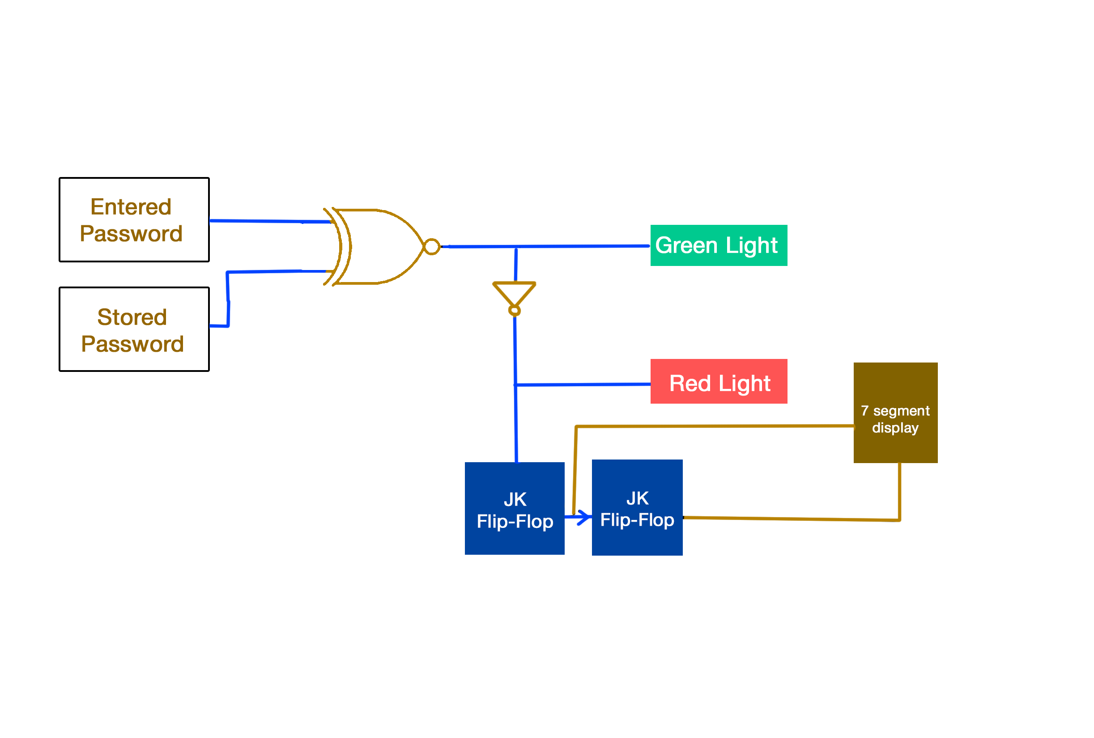
Block Diagram
555
Timer

Slide 8
Integrated Circuit
1.XNOR:74266
2.AND:7421 4 Input,7408 2 Input
3.INVERTER:7404
4.JK FLIP FLOP (COUNTER ):7473
6.BCD DECODER:7447
7.7-SEGMENT DISPLAY:Common Cathode
8.555 Timer

Slide 9
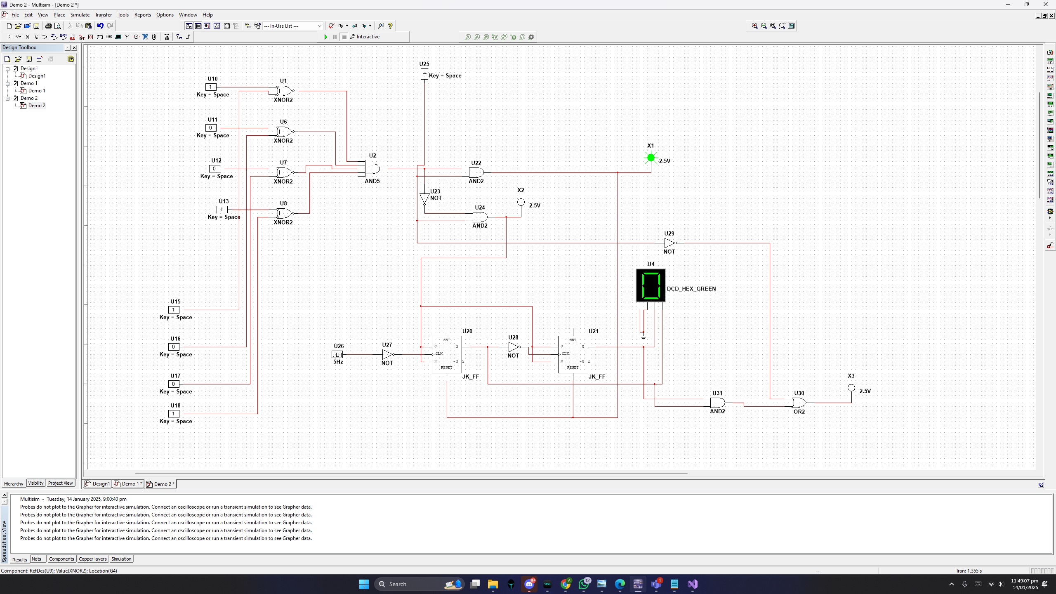

Slide 10
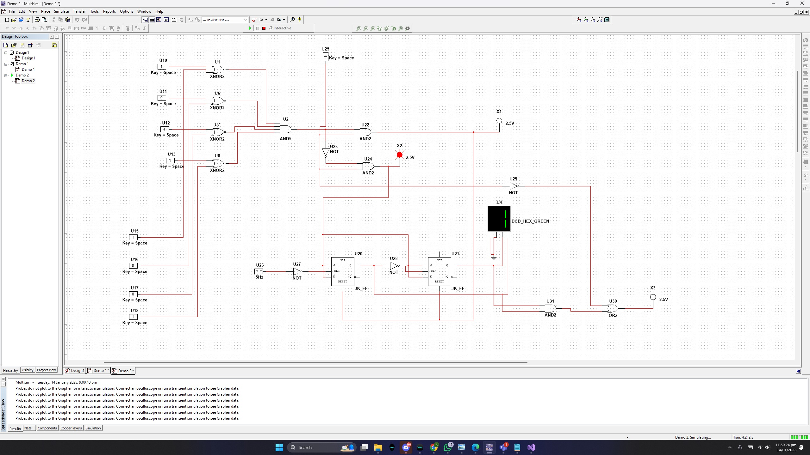

Slide 11
Methodology
Error counter resets after three wrong attempts.
Circuit Design : *DIP(Dual in line package)switches for inputting stored and entered passwords.
*XNOR gates to compare corresponding 2 passwords bits.
Error Counting : *Output of XNOR gates feeds into a JK flip-flop to count incorrect attempts. *Error counter resets after three wrong attempts.

Slide 12
Methodology
Visual Feedback : *Green LED for correct password
*Red LED for incorrect password
*Resistors regulate current for safe LED operation
Implementation :
*Assemble the circuit on a breadboard
*Components : LEDs, resistors, flip-flops, DIP switches
*Test using a power supply for functionality.

Slide 13
Results
Stored Password | Entered Password | Output | Green Light | Red Light
0 | 0 | 1
0 | 1 | 0
1 | 0 | 0
1 | 1 | 1

Slide 14
Summary:
Green light : Passwords match (XNOR outputs 1 for all bits).
Red light : Passwords do not match (XNOR outputs 0 in any bit)

Slide 15
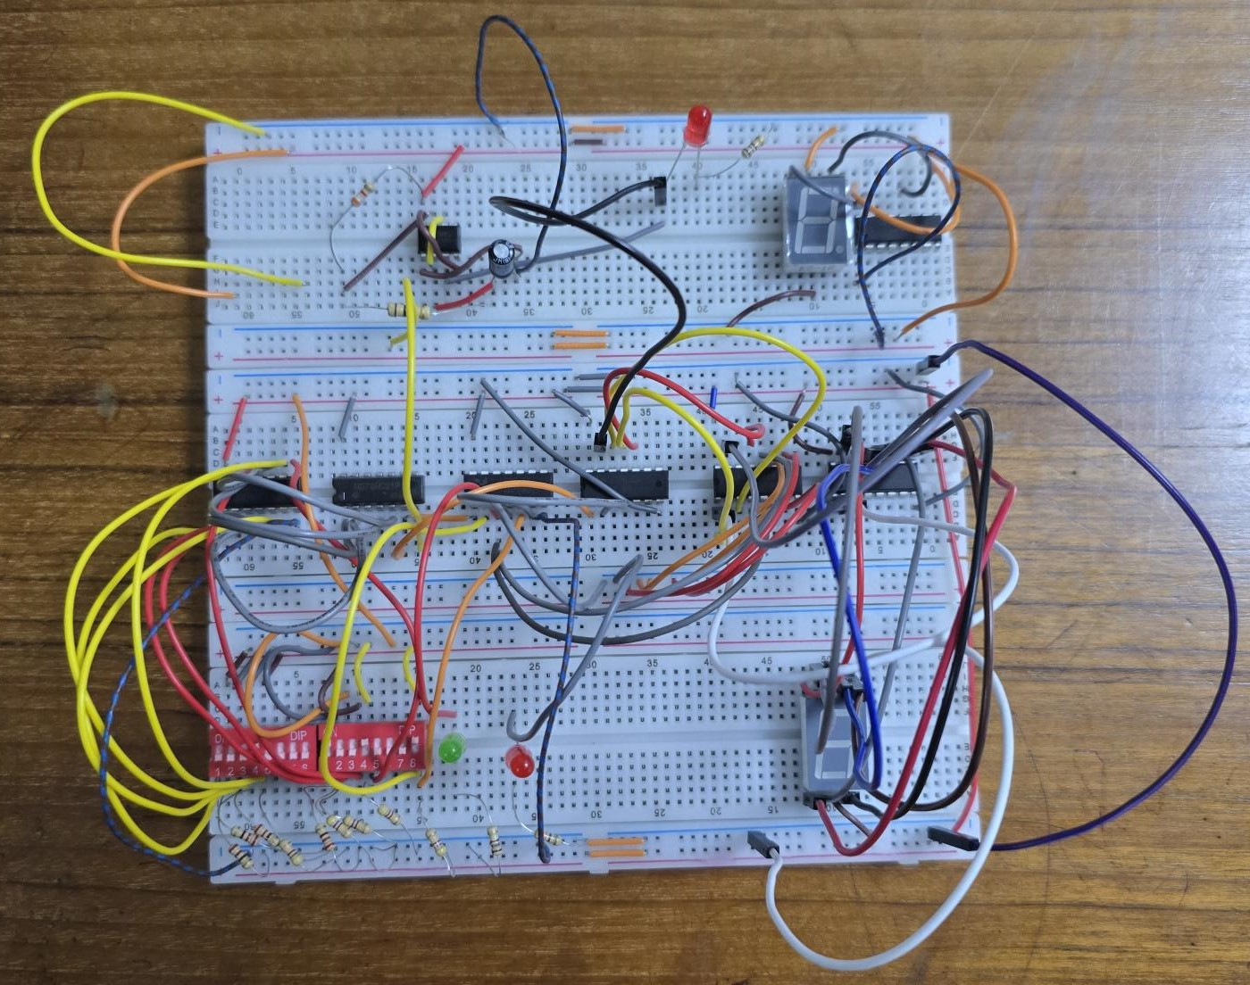
Project Prototype

Slide 16
Discussion
The stored password is hardwired or pre-set in the system through DIP switches.
The entered password is dynamically provided via another set of DIP switches.
The XNOR gates process the comparison between these two inputs to determine if they match.
This replicates a real-world password verification system, where each character or bit of a password is checked for correctness.

Slide 17

Practical Applications
Home Security : Secure doors safes, or personal belongings | Business Use : Employee login systems for restricted areas

Slide 18
Advantages
Cost-Effective : Uses of basic components | Brute-Force Protection : Resets after three incorrect attempts

Slide 19
Thank You

